Slide 1

Major Project Final Defense Presentation
A Comprehensive Study on Development of a Roman Nepali Chatbot for E-commerce Customer Care
Project Members:
Aakash Kumar Thakur (PUR077BCT003)
Kshitiz Gajurel (PUR077BCT042)
Manish Kathet (PUR077BCT044)
Manoj Kumar Baniya (PUR077BCT046)
Supervisor: Er. Pukar Karki

Slide 2
INTRODUCTION
Roman Nepali Chatbot
A chatbot designed to understand and respond to user queries in the Roman Nepali language.
Ecommerce Chatbot
An e-commerce customer bot is an automated tool designed to interact with customers on an e-commerce platform to simulate human-like conversations and assist users with various tasks.

Slide 3
PROBLEM STATEMENT
1. Manual Customer Support
2. Slow Response Time
3. Limited Language Support
(English/Nepali)

Slide 4
OBJECTIVES
Romanized Nepali E-commerce Chatbot Development
Chatbot Architecture Analysis & Optimization
3. Enhanced Response Quality with Dynamic Retrieval

Slide 5
LITERATURE REVIEW
GUS (Genial Understander System) [1] – A frame-driven dialogue system (1977) using predefined templates for structured conversations. It enabled goal-directed interactions and influenced modern intent recognition. Our chatbot applies ML-based intent classification for better Romanized Nepali support in e-commerce.
[2] Optimizes LLMs for low-resource languages like Veitnamese. Enhances chatbot accuracy despite limited data. We apply this to improve Romanized Nepali chatbot performance, ensuring better responses for e-commerce customer care.

Slide 6
METHODOLOGY

Slide 7
Chatbot
RULE BASED CHATBOT
MACHINE LEARNING CHATBOT
GENERATIVE CHATBOT

Slide 8
PREPARING DATASET
STEPS ON PREPARING DATASET
Synthetic Dataset Generation
Ecommerce Q/A pair dataset (Roman Nepali)
Data Cleaning and Filtering
Labeling Intent and Entity Dataset
Pre-Processing and Adding Prompt Template

Slide 9
Fine Tuning Dataset: 17886 (Q/A pairs)
We used GPT-4o and DeepSeek AI to generate Romanized Nepali dialogues through diverse prompts, ensuring natural chatbot conversations with a balanced mix of:
Common user intents (browsing, ordering, tracking) with suitable responses.
Varied tones (formal, informal, friendly, professional).
Multiple topics (greetings, inquiries).
To improve the diversity and quality of the dataset, we used various prompt engineering techniques (Zero Shot, Few Shot and Dynamic Scenario Prompt)
We further validate and filter our dataset final (17886)

Slide 10
Intent and Entity Dataset
- We aimed for only 4 different e-commerce intents (product-inquiry, order- tracking, order-product, payment-method).
Manually Prepared dataset on each intents.
Same dataset was used for training entity recognition model.
Query | Intent
ma saman order garna chahanxu | ORDER_PRODUCT
laptop ko price kati ho? | PRODUCT_INQUIRY
mero order ko status ke ho jankari dinu? | ORDER_TRACKING

Slide 11
Intent Classification: Dataset
WORD REPLACEMENT
chha:{cha,chhaa,xa,xha,xaa,x}
malaai:{malai,malaai,malae,molai,maalai,maalaai}
maile:{mailee,mailey,mailei,maileey}
k:{ke}
paryo:{paro,pariyo,pario,parryo,parryoo}
For Example:
Malae store location bare bataidinu paro.
Malai store location bareey bataidinu paryo.

Slide 12
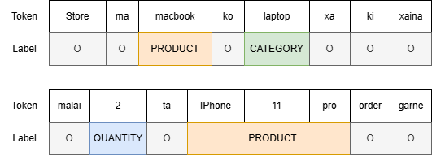
Entity Recognition: Data Labeling
Labeling Entity using Custom Labeling App

Slide 13
Formatting Fine Tuning Dataset
Prompt Template for Fine Tuning Dataset
<start_of_turn>system {SYSTEM_PROMPT}<end_of_turn>
<start_of_turn>user {USER_QUESTION} {CONTEXT}<end_of_turn>
<start_of_turn>model {MODEL_RESPONSE}<EOS>
Example Training Dataset using Prompt Template
<start_of_turn>system Timi auta e-commerce ko AI Assistant hou user le gareko question lai context herera ramro response deu.<end_of_turn>
<start_of_turn>user Samsung Galaxy ko price kati ho?
Context: product_name Samsung Galaxy, price: 1,10,000, RAM: 16GB<end_of_turn>
<start_of_turn>model Hajur Samsung Galaxy ko price Rs. 1,10,000 parxa.<EOS>

Slide 14
SYSTEM ARCHITECTURE
Three Types of Chatbot
Rule Based Chatbot (Menu Chatbot)
Machine Learning Chatbot (Dialogue System)
Generative Chat (RAG Chatbot)

Slide 15
Rule Based Chatbot

Slide 16
Rule Based Chatbot
The chatbot operates using predefined rules and structured menu-driven interactions to ensure accurate and efficient responses.
It processes user queries based on structured dialogue states and retrieves relevant data using predefined logic and generates appropriate responses for user interactions.
PRODUCT INQUIRY
ORDER PRODUCT
ORDER TRACKING

Slide 17
Rule Based Chatbot
External Knowledge Base
PRODUCT INQUIRY
Collecting entities like order_number (12345) using RegEx and Pattern Matching Techniques.
ORDER PRODUCT
For Example:
Hajur ko order {order_status} hudei xa.
Mero order number 12345 ko status ke xa?
Appropriate Response
Maaf garnu hola hajurko order number {order_number} milena.
ORDER TRACKING
Collect Entities
Perform Logic

Slide 18
System Diagram: (Rule Based Chatbot)
User Query
Product
Inquiry
Order
Tracking
Order
Product
Collect Entities
(product_name, category,..)
Collect Entities
(order_number)
Collect Entities
(product, quantity, delivery_information)
Get predefined response from template
Response

Slide 19
ML Chatbot

Slide 20
ML Chatbot: Introduction
The chatbot is developed using a machine learning-based approach that integrates multiple natural language processing (NLP) techniques to ensure accurate intent classification, entity recognition, and dialogue management through slot filling.
INTENT CLASSIFICATION
ENTITY RECOGNITION

Slide 21
ML Chatbot: Intent Classification
Product_Inquiry
Query | Intent
ma saman order garna chahanxu | ORDER_PRODUCT
laptop ko price kati ho? | PRODUCT_INQUIRY
mero order ko status ke ho jankari dinu? | ORDER_TRACKING
Bag of Word
(Feature Vector)
Order_Tracking
[1 2 1 0 0 0 .. 0]
Order_Product
[1 0 1 0 0 0 .. 0]
[0 0 1 0 0 0 .. 0]
Payment_Type

Slide 22
ML Chatbot: Entity Recognition
Conditional Random Field (CRF):
CRF is a machine learning model for sequence prediction, used in entity recognition. It considers word relationships and context for better accuracy.
Use in Entity Recognition:
CRF tags words as entities (e.g., names, locations) by analyzing surrounding words, ensuring meaningful label patterns (e.g., "New" → "York" as a location).

Slide 23
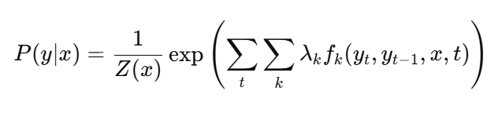
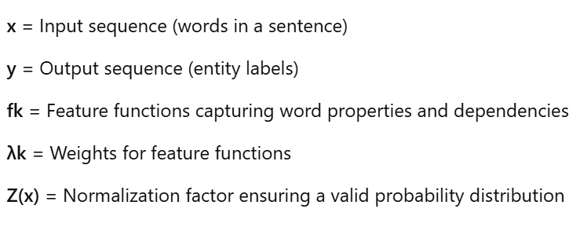
CRF Formula:
Example:
"Buy a red Nike running shoe in size 10."
Color
Brand
Product
Size

Slide 24
INTENT CLASSIFICATION
ENTITY RECOGNITION
Dialogue Manager
(Dialogue State Tracking)
External Knowledge Base
Natural Language Understanding
User Query
Slot Filling
Natural Language Generation

Slide 25
Generative Chatbot

Slide 26
Generative Chatbot: Introduction
Uses Deep Learning Techniques to create responses from scratch so generative.
Unlike Rule-Based and Dialogue System Chatbot, which select responses from a predefined set based on user input, generative chatbots generate new responses dynamically, tailoring them to the specific context and content of the conversation.
Trained on large amount on text data.
Much more complex than rule based and retrieval based approach.
RNN based
LSTM (Long Short Term Memory)
GRU (Gated Recurrent Unit)
Transformer based
GPT (Open AI)
Llama (Meta AI)
Gemma (Google Research)

Slide 27
Fine Tuning: Gemma2 (9 Billion Parameter Model)
Gemma 2 9B
Model Architecture: A 9-billion parameter decoder-only transformer model.
Key Features: Uses optimized attention mechanisms and rotary positional embeddings for better efficiency
Advantages: Supports fast inference, efficient fine tuning and domain adaptation.
Why Gemma 2 9B?
Its pretrained model understands Romanized Nepali, making text tokenization easier.

Slide 28
Training of Gemma 2 Model
17886 Instructional datasets used.
Fine-tuned on Google Colab which a free Tesla T4 GPU (16GB VRAM).
Model Storage on Hugging Face for easy access.
Deployed using Google Colab with API tunneling.
Pinecone vector store utilize for dynamic data retrieval.

Slide 29
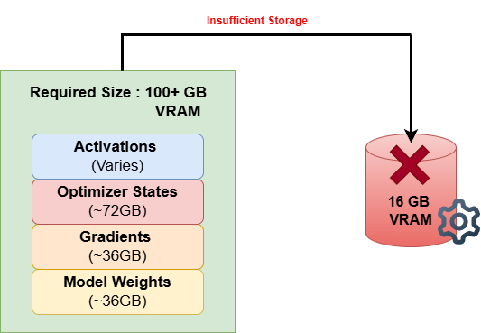
Fine Tuning: Computation Required for Fine Tuning
Model Weights Storage: Loads pre-trained parameters.
Gradient Storage: Stores weight updates during training.
Optimizer States: Maintains momentum and scaling factors.
Activations Memory: Holds intermediate outputs for backpropagation.
Total Requirement: Exceeds standard GPU limits, making full fine-tuning infeasible.
Google Colab
Size
Gemma 2 9b
Model Size
SOLUTION:
Used PEFT techniques for memory-efficient fine-tuning.

Slide 30
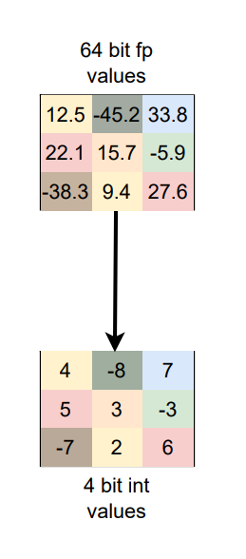
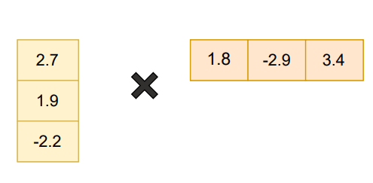
Fine Tuning: PEFT Technique
1. Quantization
Reduces model weight precision from 64-bit/32-bit to 4-bit, lowering memory use.
2. LoRA & QLoRA
Freezes most model weights, trains only small adapter layers for efficiency.
Applies 4-bit quantization before using LoRA, further reducing memory needs.
Quantization
LoRA Decomposition

Slide 31
System Diagram (RAG Chatbot)
Vector Store
Ecommerce Related Data
Embeddings
User Query
Retrieve Useful Context
Generated Response
Fine Tuned
GEMMA
Format Prompt
(prompt_template)

Slide 32
Result and Discussion
Criteria | Rule Based Chatbot | ML Based Chatbot | LLM Based Chatbot
1. Query Adaptability | Predefined flows, struggles with deviation | Handles some variations, misclassifies unseen phrasing | Handles diverse queries, occasional hallucinations
2. Response Quality | Static responses, no personalization | Template-based, misclassifies tokens | Context-aware, BLEU score: 36.13, human ratings: 8-10, better entity recognition
3. Resource Efficiency | Low cost, limited functionality | Moderate cost, balanced performance | High cost, advanced capabilities

Slide 33
Challenges
Lack of Roman Nepali Dataset publicly available to experiment.
Fine-tuning large language models for Romanized Nepali remains challenging due to limited pre-trained resources.
Hardware resource constraint to train/fine tune large language model.
Hallucinations of LLM (for ecommerce customer care we need accurate responses).

Slide 34
Conclusion
- We explored chatbot techniques for e-commerce in Roman Nepali language focusing on rule-based, retrieval-based and generation-based approach.
- We Collected and prepared a diverse dataset to train machine learning model.
- Fine tuned small model [gemma2 9B] to learn the techniques for efficiently fine tuning on low resource.

Slide 35
References
[1] D. G. Bobrow, R. M. Kaplan, M. Kay, D. A. Norman, H. Thompson, and T. Winograd, “Gus, a frame-driven dialog system,” Artificial Intelligence, vol. 8, no. 2, pp. 155–173, Apr. 1977. [Online]. Available: https://doi.org/10.1016/0004-3702(77)90018-2
[2] V.-T. Doan, Q.-T. Truong, D.-V. Nguyen, V.-T. Nguyen, and T.-N. N. Luu, “Efficient finetuning large language models for Vietnamese chatbot,” arXiv preprint arXiv:2309.04646, 2023. [Online]. Available: https://arxiv.org/abs/2309.04646

Slide 36
Thank You

